Slide 1
QPTM Product Overview
September 29, 2017

Slide 2
Agenda
Intro
Business Case/Regulatory Environment
External Access
System Flow
  Pre-Flow
    Nominations
    Confirmations
    Scheduling
  Post-Flow
    Allocations
    Inventory
    Invoicing
Acronym Review

Slide 3
Intro
What is QPTM?
  Quorum Pipeline Transaction Management
  Comprehensive software solution for natural gas pipeline operators to manage business transactions with shippers – including contracts, nominations, scheduling, balancing, invoicing and accounting
Original intent
  Regulated interstate pipelines
  Functionality works for intrastate pipelines, LDCs, storage facilities, and some gas gathering systems
Notes:
Regulated by FERC; use NAESB standards
These standards were created so that external shippers could be guaranteed somewhat consistent information across pipelines
They dictate what fields we have, how they are named, code values, where buttons have to be, etc.

Slide 4























Quorum Pipeline Clients
22 QPTM Clients
  Interstate pipelines (24)
  Intrastate pipelines (24)
  Gathering systems (6)
  Storage facilities (17)
  Distribution systems (17)
  Canadian pipelines (3)
  Hub facilities (2)
myQuorum Pipeline is the industry leader:
22 clients running 90+ assets on over 50,000 miles of pipeline in the U.S. and Canada
Notes:
We don’t have Crestwood, Whitewater, or Cenagas on this.

Slide 5
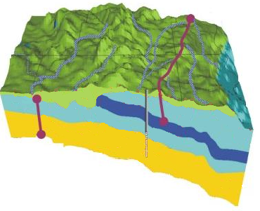
Business Case/Regulatory Environment
UPSTREAM
MIDSTREAM
INTRASTATE PIPELINE
INTERSTATE PIPELINE
LOCAL
DISTRIBUTION
COMPANY
Well Heads
State Line
Storage
Meters
Processing
Plant/
Terminal
LDC
Gathering
Lines
Physical value chain from wellhead to burner tip

Slide 6
Business Case/Regulatory Environment
QPTM
UPSTREAM
MIDSTREAM
INTRASTATE PIPELINE
INTERSTATE PIPELINE
LOCAL
DISTRIBUTION
COMPANY
Well Heads
State Line
Storage
Meters
Processing
Plant/
Terminal
LDC
Gathering
Lines
Physical value chain from wellhead to burner tip

Slide 7
Business Case/Regulatory Environment
Supply
And
Demand

Slide 8
Business Case/Regulatory Environment
Supply
And
Demand

Slide 9
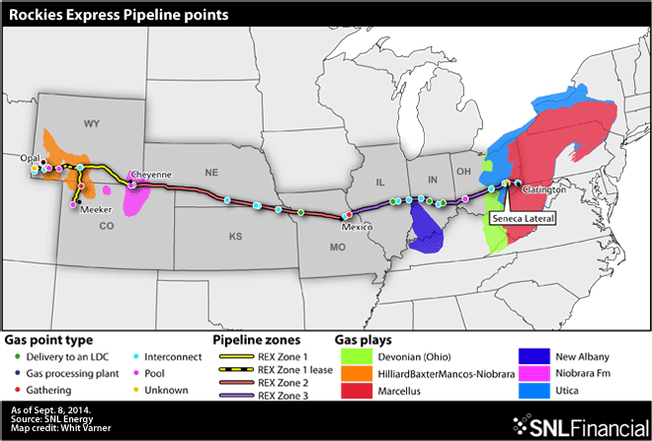
Business Case/Regulatory Environment
Notes:
1,679 miles
Meeker CO all the way to Clarington OH
Crossing 8 states in the process
Diameter varying from 36in to 42in
Sources:
http://www.hydrocarbons-technology.com/projects/rockies_express/

Slide 10
Business Case/Regulatory Environment
5.6 Billion Dollar Construction Cost
Notes:
Source: http://www.hydrocarbons-technology.com/projects/rockies_express/

Slide 11
Business Case/Regulatory Environment
Unique economic situation and high barriers to entry make natural market competition all but impossible
Pipelines are thus highly regulated due to their essential monopoly
Regulatory friends:
  Interstate:
    NAESB – North American Energy Standards Board
    FERC – Federal Energy Regulation Commission
  Intrastate:
    State level regulatory bodies (i.e. RRC in Texas)

Slide 12
Business Case/Regulatory Environment
A Tariff is drafted to dictate VERY specifically how all business is to be transacted across the pipeline
Unique to each pipeline
Approved by the applicable regulatory body
Example!

Slide 13
External Accessibility
Clients
  Our clients are the pipeline operators
  Their clients are the shippers
Customer Activities Website (CAW) app is a portal for the external users to do their business on the pipeline
  Currently separate executable available on Citrix (or the Web in v16!)

Slide 14
QPTM System Flow
Master Data
Contracts, Rates, Business Associates, Locations
Pre-Flow
Post-Flow
Nominations
Shipper (external) requesting when, where and how much gas they want to move
Measurement Interface
Allocations
Confirmations
Interconnect operator (external) reconciling requests from both pipelines
Inventory
Capacity Allocations
Pipeline operator making sure there is enough capacity and making cuts
Invoicing
All of this happens 5x / day
Notes:
This is the entire QPTM data flow…

Slide 15
QPTM System Flow
Master Data
Contracts, Rates, Business Associates, Locations
Pre-Flow
Post-Flow
Nominations
Shipper (external) requesting when, where and how much gas they want to move
Measurement Interface
Allocations
Confirmations
Interconnect operator (external) reconciling requests from both pipelines
Inventory
Capacity Allocations
Pipeline operator making sure there is enough capacity and making cuts
Invoicing
All of this happens 5x / day
Notes:
This is the entire QPTM data flow…

Slide 16
Master Data
Pipeline Admin
  TSPs – pipeline owner; used for security
Locations
  Shared Meter screen not required
  QPTM’s Location Maintenance screen
    Shared (Esuite) and extension tables
Contracts
  Quantities, locations
  Terms here are used in nominations, capacity allocation, imbalance cashout, billing
Notes:
TSPs: Legal entity which owns the pipeline. Controls security in QPTM.
Cycles: Interstate pipelines are currently required to have 5 cycles per gas day. Cycles are deadlines for different pipeline activities. Having standardized cycles allows the nationwide network of pipelines to synchronize with each other. We’ll see cycles in use in the Nominations module.

Slide 17
Rates
Used in nominations (fuel) and billing ($ charges)
Supports several different price types
Can have different rates for each path
Can create a rate for a specific contract OR for all contracts within a given Type of Service

Slide 18
Request for Service
What is it?
  Method for external users to request contract amendments, including rate changes
Who uses it?
  External shippers (optional)
  Internal departments – for approval, award
Notes:
Why not just create master data in Contract Maintenance and Rate Maintenance?
Don’t want to open up those screens to external users. RFS is included in the CAW.
Validations
Approval workflow
Greater control and security

Slide 19
QPTM System Flow
Master Data
Contracts, Rates, Business Associates, Locations
Pre-Flow
Post-Flow
Nominations
Shipper (external) requesting when, where and how much gas they want to move
Measurement Interface
Allocations
Confirmations
Interconnect operator (external) reconciling requests from both pipelines
Inventory
Capacity Allocations
Pipeline operator making sure there is enough capacity and making cuts
Invoicing
All of this happens 5x / day
Notes:
This is the entire QPTM data flow…

Slide 20
Nominations
What is it?
  Request to move a quantity of gas at given locations for a for a specific timeframe
  i.e. “I’d like to bring 500 Dth onto the pipeline at Point A and then take 500 Dth off the pipeline at Point B, every day for the next 5 days”
Who uses it?
  The nomination is submitted by the service requester (shipper) in the QPTM Web App
Notes:
Nomination Submission:
NAESB regulated (lots of fields)
Cycles
31-day pop-up
Errors tab
Nomination Maintenance
Calendar
31-day pop-up

Slide 21
QPTM System Flow
Master Data
Contracts, Rates, Business Associates, Locations
Pre-Flow
Post-Flow
Nominations
Shipper (external) requesting when, where and how much gas they want to move
Measurement Interface
Allocations
Confirmations
Interconnect operator (external) reconciling requests from both pipelines
Inventory
Capacity Allocations
Pipeline operator making sure there is enough capacity and making cuts
Invoicing
All of this happens 5x / day
Notes:
This is the entire QPTM data flow…

Slide 22
Confirmations
What is it?
  Agreement between interconnecting parties to receive / deliver a specified quantity of gas for a specified date under a contract based on submitted nominations
Who uses it?
  Confirmation cuts are made by the operator of each interconnect point in the QPTM Web app
TSP 1 – Midwest Pipeline
TSP 2 – ANR
Midwest noms show that 500 dth are being delivered at the interconnect
…But ANR noms show that only 450 is being picked up at the interconnect.

Slide 23
QPTM System Flow
Master Data
Contracts, Rates, Business Associates, Locations
Pre-Flow
Post-Flow
Nominations
Shipper (external) requesting when, where and how much gas they want to move
Measurement Interface
Allocations
Confirmations
Interconnect operator (external) reconciling requests from both pipelines
Inventory
Capacity Allocations
Pipeline operator making sure there is enough capacity and making cuts
Invoicing
All of this happens 5x / day
Notes:
This is the entire QPTM data flow…

Slide 24
Capacity Allocation Scheduling
What is it?
  Some nominations need to get cut since they obviously won’t all fit
Who uses it?
  Internal schedulers monitor capacity vs. scheduled quantity for each cycle
Pipe can hold this much gas
TSP has “orders” (nominations) for this much

Slide 25
QPTM System Flow
Master Data
Contracts, Rates, Business Associates, Locations
Pre-Flow
Post-Flow
Nominations
Shipper (external) requesting when, where and how much gas they want to move
Measurement Interface
Allocations
Confirmations
Interconnect operator (external) reconciling requests from both pipelines
Inventory
Capacity Allocations
Pipeline operator making sure there is enough capacity and making cuts
Invoicing
All of this happens 5x / day
Notes:
This is the entire QPTM data flow…

Slide 26
Cycles
  The need for gas can change throughout the day and is dynamic
  We break the “Gas Day” up into different cycles to allow shippers to change their nominations multiple times per Gas Day
  Having standardized cycles also allows the nationwide network of pipelines to synchronize with each other
  The current standard gas day, as defined by NAESB 3.0, has five cycles, 2 pre-flow cycles and three Intraday

Slide 27
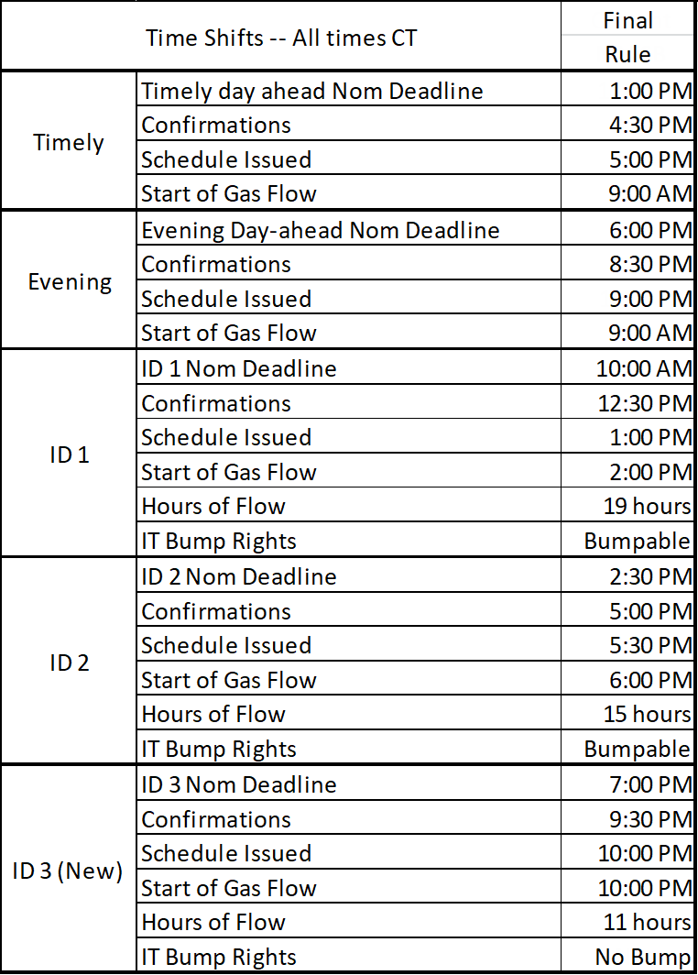
Cycles
The Five Cycles of the Standard NAESB 3.0 Gas Day

Slide 28
NAESB Standard Gas Day
Effective April 1, 2016
Timely
1:00 PM
Noms
4:30 PM
Confs
5:00 PM
Sched
Deadlines for next gas day’s Timely and Evening cycles
(Gas Day Relation = -1)
Evening
6:00 PM
Noms
8:30 PM
Confs
9:00 PM
Sched
Gas Day 1
Gas Day 2
9:00AM
9:00AM
Intraday 1
Gas Flow Start 2:00 PM
10:00 AM
Noms
12:30 PM
Confs
1:00 PM
Sched
Deadlines for current gas day’s ID1, ID2, and ID3 cycles
(Gas Day Relation = 0)
Intraday 2
Gas Flow Start 6:00 PM
2:30 PM
Noms
5:00 PM
Confs
5:30 PM
Sched
Intraday 3
Gas Flow Start 10:00 PM
7:00 PM
Noms
9:30 PM
Confs
10:00 PM
Sched

Slide 29
NAESB Standard Gas Day
Effective April 1, 2016
Timely
1:00 PM
Noms
4:30 PM
Confs
5:00 PM
Sched
Deadlines for next gas day’s Timely and Evening cycles
(Gas Day Relation = -1)
Everything we’ve talked about so far in the Pre-Flow Activities, we literally do five times per day!
Evening
6:00 PM
Noms
8:30 PM
Confs
9:00 PM
Sched
Gas Day 1
Gas Day 2
9:00AM
9:00AM
Intraday 1
Gas Flow Start 2:00 PM
10:00 AM
Noms
12:30 PM
Confs
1:00 PM
Sched
Deadlines for current gas day’s ID1, ID2, and ID3 cycles
(Gas Day Relation = 0)
Intraday 2
Gas Flow Start 6:00 PM
2:30 PM
Noms
5:00 PM
Confs
5:30 PM
Sched
Intraday 3
Gas Flow Start 10:00 PM
7:00 PM
Noms
9:30 PM
Confs
10:00 PM
Sched

Slide 30
QPTM System Flow
Master Data
Contracts, Rates, Business Associates, Locations
Pre-Flow
Post-Flow
Nominations
Shipper (external) requesting when, where and how much gas they want to move
Measurement Interface
Allocations
Confirmations
Interconnect operator (external) reconciling requests from both pipelines
Inventory
Capacity Allocations
Pipeline operator making sure there is enough capacity and making cuts
Invoicing
All of this happens 5x / day
Notes:
This is the entire QPTM data flow…

Slide 31
Allocations
What is it?
  Dividing the measured quantity at a location to the customers and contracts defined by the nominations/scheduled quantities
  i.e. We had 3 different shippers who all nominated 500 Dth at Point A, but we only measured 1,200 Dth; now we have to allocate that out to the 3 contracts
Who uses it?
  Service requesters and operators provide information for pre-determined allocations (PDAs)
Notes:
Who? Other than PDAs, the allocations process should be self-sustaining (no manual input required). At this point, it uses inputs from the system.

Slide 32
QPTM System Flow
Master Data
Contracts, Rates, Business Associates, Locations
Pre-Flow
Post-Flow
Nominations
Shipper (external) requesting when, where and how much gas they want to move
Measurement Interface
Allocations
Confirmations
Interconnect operator (external) reconciling requests from both pipelines
Inventory
Capacity Allocations
Pipeline operator making sure there is enough capacity and making cuts
Invoicing
All of this happens 5x / day
Notes:
This is the entire QPTM data flow…

Slide 33
Inventory
What is it?
  Customer Accounts: Tracks customer imbalances (used for invoicing later)
    i.e. If we were allocated 400 Dth on at the receipt point, but took out 450 Dth at the delivery point, then my imbalance is -50 Dth (and I owe the pipeline)
  Pipeline Inventory: Tracks pipeline imbalances (used to evaluate fuel rates)
Who uses it?
  Shippers track imbalances throughout the month; want a small imbalance to avoid additional charges
  Pipeline operators evaluate gain and loss on the pipeline to ensure fuel rates are accurate

Slide 34
QPTM System Flow
Master Data
Contracts, Rates, Business Associates, Locations
Pre-Flow
Post-Flow
Nominations
Shipper (external) requesting when, where and how much gas they want to move
Measurement Interface
Allocations
Confirmations
Interconnect operator (external) reconciling requests from both pipelines
Inventory
Capacity Allocations
Pipeline operator making sure there is enough capacity and making cuts
Invoicing
All of this happens 5x / day
Notes:
This is the entire QPTM data flow…

Slide 36
Billing
What is it?
  How our clients get paid!
  The TSP matches the rates we created earlier against our Allocated quantities, other contractual obligations, and imbalances from earlier to create invoices and bill the TSP’s customers
Who uses it?
  Internal accountants prepare and verify the invoices
  Shippers log into CAW to view and receive the invoices

Slide 37
QPTM System Flow
Master Data
Contracts, Rates, Business Associates, Locations
Pre-Flow
Post-Flow
Nominations
Shipper (external) requesting when, where and how much gas they want to move
Measurement Interface
DONE!
Allocations
Confirmations
Interconnect operator (external) reconciling requests from both pipelines
Inventory
Capacity Allocations
Pipeline operator making sure there is enough capacity and making cuts
Invoicing
All of this happens 5x / day
Notes:
This is the entire QPTM data flow…

Slide 38
Acronym Recap
QPTM
LDC
NAESB
FERC
CAW
TSP
QPTM – Quorum Pipeline Transaction Management
LDC – Local Distribution Company
NAESB – North American Energy Standards Board
FERC – Federal Energy Regulation Commission
CAW – Customer Activities Website (→ Web!)
TSP – Transportation Service Provider

Slide 39



Questions?
Questions?
HOUSTON  DALLAS  CALGARY
Proprietary & Confidential – Do Not Copy or Distribute
Notes:
Sir Winston Churchill, the cat.

